Slide 1
SURVEY APPLICATION

Slide 2
DESCRIPTION
User Authentication: Users log into the app using their credentials, ensuring that survey responses are tied to verified individuals and that access to surveys is secure and managed.
Survey Downloading: The app connects to a server to download available questionnaires, which are saved locally on the device for easy offline access. This allows users to fill out surveys even when they don't have a network connection.
Survey Browsing: Users can view a list of all downloaded surveys within the app. This list shows the available surveys in an organized manner, allowing users to easily browse and choose a survey they wish to complete.
Survey Selection: After browsing, users can select a specific survey to view its details and proceed to start filling it out. This intuitive selection process ensures that users can navigate through the app smoothly and pick the right survey without hassle.
Survey Completion Interface: The survey interface supports multiple question types, including multiple-choice, text input, rating scales, and checkboxes.
Automatic Syncing of Responses: The app is designed to automatically sync completed survey responses with the server every 15 minutes, provided a network connection is available. This regular syncing ensures that data remains up-to-date without requiring manual uploads from the user.

Slide 3
Main Activity.java:
import android.app.NotificationChannel import android.app.NotificationManager
import android.content.Context import android.content.Intent import android.content.SharedPreferences import android.graphics.Bitmap import android.os.Build import android.os.Bundle
import android.view.Menu import android.view.MenuItem import android.widget.Toast
import androidx.activity.viewModels import androidx.appcompat.app.AppCompatActivity
import androidx.lifecycle.LiveData import androidx.navigation.NavController
import androidx.navigation.fragment.findNavController import androidx.work.*
import com.google.android.material.dialog.MaterialAlertDialogBuilder
import com.google.common.hash.Hashing import com.keronei.survey.core.Constants
import com.keronei.survey.core.Constants.IS_LOGGED_IN_KEY
import com.keronei.survey.core.Constants.PASS_KEY
import com.keronei.survey.core.Constants.PHONE_NUMBER_KEY
import com.keronei.survey.core.Constants.REQUEST_IMAGE_CAPTURE
import com.keronei.survey.core.Constants.WORKMAGAER_TAG
import com.keronei.survey.core.workmanager.SubmissionsWorker
import com.keronei.survey.presentation.ui.viewmodel.QuestionsHelperViewModel
import dagger.hilt.android.AndroidEntryPoint import kotlinx.coroutines.ExperimentalCoroutinesApi
import java.nio.charset.Charset import java.util.concurrent.TimeUnit
import javax.inject.Inject

Slide 4
@ExperimentalCoroutinesApi
@AndroidEntryPoint
class MainActivity : AppCompatActivity() {
private val helperViewModel: QuestionsHelperViewModel by viewModels()
private lateinit var workManager: WorkManager
private lateinit var outputWorkInfo: LiveData<List<WorkInfo>>
private lateinit var controller: NavController
@Inject
lateinit var preferences: SharedPreferences
override fun onCreate(savedInstanceState: Bundle?) {
super.onCreate(savedInstanceState)
setContentView(R.layout.activity_main)
createNotificationChannel()
syncResponsesPeriodically()
navigateToHomeOrLogin()
preparePassword()
}

Slide 5
private fun preparePassword() {
val hasPasswordSet = preferences.contains(PASS_KEY)
if (!hasPasswordSet) {
val passwordHash = Hashing.sha256()
.hashString(getString(R.string.pass), Charset.defaultCharset())
preferences.edit()
.putLong(PASS_KEY, passwordHash.padToLong())
.apply()
}
}
private fun navigateToHomeOrLogin() {
val hostFragment = supportFragmentManager.findFragmentById(R.id.nav_host_fragment_main)
hostFragment?.let {
controller = it.findNavController()
controller.addOnDestinationChangedListener { _, destination, _ ->
if (destination.id == R.id.homeFragment) {
val isLoggedIn = preferences.getBoolean(IS_LOGGED_IN_KEY, false)
if (!isLoggedIn) {
controller.navigate(R.id.action_homeFragment_to_loginFragment)
}
}
}}}

Slide 6
override fun onCreateOptionsMenu(menu: Menu?): Boolean {
super.onCreateOptionsMenu(menu)
menuInflater.inflate(R.menu.main_menu, menu)
return true
}
override fun onOptionsItemSelected(item: MenuItem): Boolean {
super.onOptionsItemSelected(item)
if (item.itemId == R.id.profile) {
if (this::controller.isInitialized) {
val currentDestination = controller.currentDestination
if (currentDestination?.id != R.id.loginFragment) {
val savedPhone = preferences.getString(PHONE_NUMBER_KEY, "Empty Phone")
MaterialAlertDialogBuilder(this)
.setMessage("You are currently logged in.")
.setPositiveButton("Cancel") { dialog, _ -> dialog.dismiss() }
.setNegativeButton("Logout") { dialog, _ ->
dialog.dismiss()
preferences.edit()
.remove(IS_LOGGED_IN_KEY)
.remove(PHONE_NUMBER_KEY)
.apply()
controller.navigate(R.id.action_homeFragment_to_loginFragment)
}

Slide 7
.setTitle(savedPhone)
.setIcon(R.drawable.ic_baseline_account_circle_24)
.create()
.show()
} else {
MaterialAlertDialogBuilder(this)
.setMessage("You are currently not logged in.\n\nUse your phone number and provided password to log in.")
.setPositiveButton("OK") { dialog, _ -> dialog.dismiss() }
.setTitle("No Account")
.setIcon(R.drawable.ic_baseline_account_circle_24)
.create()
.show()}}}
return true}
override fun onActivityResult(requestCode: Int, resultCode: Int, data: Intent?) {
super.onActivityResult(requestCode, resultCode, data)
if (requestCode == REQUEST_IMAGE_CAPTURE && resultCode == RESULT_OK) {
helperViewModel.setBitmap(Bitmap.createBitmap(1, 1, Bitmap.Config.ARGB_8888))
} else {
Toast.makeText(this, "Capture was not successful.", Toast.LENGTH_SHORT).show()
}
}

Slide 8
private fun syncResponsesPeriodically() {
workManager = WorkManager.getInstance(applicationContext)
outputWorkInfo = workManager.getWorkInfosByTagLiveData(WORKMAGAER_TAG)
val workAlreadyStarted = outputWorkInfo.value?.any { it.tags.contains(WORKMAGAER_TAG) } == true
if (!workAlreadyStarted) {
val internetRequirementConstraint = Constraints.Builder()
.setRequiredNetworkType(NetworkType.CONNECTED)
.build()
val notifyTemperatureWorkRequest = PeriodicWorkRequestBuilder<SubmissionsWorker>(
15, TimeUnit.MINUTES
)
.setConstraints(internetRequirementConstraint)
.addTag(WORKMAGAER_TAG)
.build()
workManager.enqueueUniquePeriodicWork(
Constants.WORK_ID,
ExistingPeriodicWorkPolicy.REPLACE,
notifyTemperatureWorkRequest
)
}
}

Slide 9
private fun createNotificationChannel() {
if (Build.VERSION.SDK_INT >= Build.VERSION_CODES.O) {
val name = getString(R.string.notificationchannel_name)
val descriptionText = getString(R.string.channel_desc)
val importance = NotificationManager.IMPORTANCE_DEFAULT
val channel = NotificationChannel(Constants.NOTIFICATION_CHANNEL_ID, name, importance).apply {
description = descriptionText
}
val notificationManager = getSystemService(Context.NOTIFICATION_SERVICE) as NotificationManager
notificationManager.createNotificationChannel(channel)
}
}
}

Slide 10
Activity_main.xml:
<?xml version="1.0" encoding="utf-8"?>
<androidx.constraintlayout.widget.ConstraintLayout xmlns:android="http://schemas.android.com/apk/res/android"
xmlns:app="http://schemas.android.com/apk/res-auto"
xmlns:tools="http://schemas.android.com/tools"
android:layout_width="match_parent"
android:layout_height="match_parent"
tools:context="com.keronei.survey.MainActivity">
<androidx.constraintlayout.widget.ConstraintLayout
android:layout_width="match_parent"
android:layout_height="match_parent"
tools:context=".application.MainActivity">
<androidx.fragment.app.FragmentContainerView
android:id="@+id/nav_host_fragment_main"
android:name="androidx.navigation.fragment.NavHostFragment"
android:layout_width="0dp"
android:layout_height="0dp"
app:defaultNavHost="true" app:layout_constraintStart_toStartOf="parent"
app:layout_constraintTop_toTopOf="parent"
app:navGraph="@navigation/base_nav" />
</androidx.constraintlayout.widget.ConstraintLayout>
</androidx.constraintlayout.widget.ConstraintLayout>

Slide 11
<TextView
android:id="@+id/textView2"
android:layout_width="wrap_content"
android:layout_height="wrap_content"
android:layout_marginStart="48dp"
android:layout_marginLeft="48dp"
android:layout_marginTop="32dp"
android:text="@string/total_runs"
android:textColor="@color/Black"
android:textSize="30sp"
app:layout_constraintStart_toStartOf="parent"
app:layout_constraintTop_toTopOf="parent" />
<Button
android:id="@+id/two"
android:layout_width="72dp"
android:layout_height="77dp"
android:layout_marginEnd="188dp"
android:background="@drawable/ic_launcher_background"
android:backgroundTint="@color/AliceBlue"
android:text="@string/_2"
android:textColor="@color/BlueViolet"
android:textSize="30sp"
app:layout_constraintBottom_toBottomOf="parent"
app:layout_constraintEnd_toEndOf="parent"

Slide 12
app:layout_constraintHorizontal_bias="1.0"
app:layout_constraintStart_toStartOf="parent"
app:layout_constraintTop_toTopOf="parent"
app:layout_constraintVertical_bias="0.391" />
<Button
android:id="@+id/six"
android:layout_width="72dp"
android:layout_height="77dp"
android:text="@string/_6"
android:textColor="@color/BlueViolet"
android:textSize="30sp"
app:layout_constraintBottom_toBottomOf="parent"
app:layout_constraintEnd_toEndOf="parent"
app:layout_constraintHorizontal_bias="0.879"
app:layout_constraintStart_toStartOf="parent"
app:layout_constraintTop_toTopOf="parent"
app:layout_constraintVertical_bias="0.553" />
<Button
android:id="@+id/no"
android:layout_width="104dp"
android:layout_height="81dp"
android:text="@string/no_ball"
android:textColor="@color/BlueViolet"
android:textSize="20sp"

Slide 13
app:layout_constraintBottom_toBottomOf="parent"
app:layout_constraintEnd_toEndOf="parent"
app:layout_constraintHorizontal_bias="0.091"
app:layout_constraintStart_toStartOf="parent"
app:layout_constraintTop_toTopOf="parent"
app:layout_constraintVertical_bias="0.703" />
<Button
android:id="@+id/wide"
android:layout_width="86dp"
android:layout_height="75dp"
android:text="@string/wide_ball"
android:textColor="@color/BlueViolet"
android:textSize="20sp"
app:layout_constraintBottom_toBottomOf="parent"
app:layout_constraintEnd_toEndOf="parent"
app:layout_constraintHorizontal_bias="0.486"
app:layout_constraintStart_toStartOf="parent"
app:layout_constraintTop_toTopOf="parent"
app:layout_constraintVertical_bias="0.696" />
<Button
android:id="@+id/three"
android:layout_width="72dp"
android:layout_height="77dp"
android:background="@drawable/ic_launcher_background"

Slide 14
android:text="@string/_3"
android:textColor="@color/BlueViolet"
android:textSize="30sp"
app:layout_constraintBottom_toBottomOf="parent"
app:layout_constraintEnd_toEndOf="parent"
app:layout_constraintHorizontal_bias="0.586"
app:layout_constraintStart_toEndOf="@+id/two"
app:layout_constraintTop_toTopOf="parent"
app:layout_constraintVertical_bias="0.391" />
<Button
android:id="@+id/one"
android:layout_width="72dp"
android:layout_height="77dp"
android:background="@drawable/ic_launcher_background"
android:backgroundTint="@color/AliceBlue"
android:text="@string/_1“
android:textColor="@color/BlueViolet"
android:textSize="30sp"
app:layout_constraintBottom_toBottomOf="parent"
app:layout_constraintEnd_toStartOf="@+id/two"
app:layout_constraintHorizontal_bias="0.349"
app:layout_constraintStart_toStartOf="parent"
app:layout_constraintTop_toTopOf="parent"

Slide 15
app:layout_constraintVertical_bias="0.391" />
<Button
android:id="@+id/four"
android:layout_width="72dp"
android:layout_height="77dp"
android:background="@drawable/ic_launcher_background"
android:text="@string/_4"
android:textColor="@color/BlueViolet"
android:textSize="30sp"
app:layout_constraintBottom_toBottomOf="parent"
app:layout_constraintEnd_toStartOf="@+id/six"
app:layout_constraintHorizontal_bias="0.157"
app:layout_constraintStart_toStartOf="parent"
app:layout_constraintTop_toTopOf="parent"
app:layout_constraintVertical_bias="0.564" />
<EditText
android:id="@+id/runs"
android:layout_width="123dp"
android:layout_height="50dp"
android:autofillHints=""
android:ems="10"
android:inputType="number"
android:text="@string/_0"
android:textColor="@color/DarkRed"

Slide 16
android:textSize="28sp"
android:textStyle="bold"
app:layout_constraintBottom_toBottomOf="parent"
app:layout_constraintEnd_toEndOf="parent"
app:layout_constraintHorizontal_bias="0.857"
app:layout_constraintStart_toStartOf="parent"
app:layout_constraintTop_toTopOf="parent"
app:layout_constraintVertical_bias="0.052" />
<EditText
android:id="@+id/out"
android:layout_width="123dp"
android:layout_height="50dp"
android:autofillHints=""
android:ems="10"
android:inputType="number"
android:text="@string/_0"
android:textColor="@color/DarkRed"
android:textSize="28sp"
android:textStyle="bold"
app:layout_constraintBottom_toBottomOf="parent"
app:layout_constraintEnd_toEndOf="parent"
app:layout_constraintHorizontal_bias="0.857"
app:layout_constraintStart_toStartOf="parent"
app:layout_constraintTop_toTopOf="parent"
app:layout_constraintVertical_bias="0.207" />

Slide 17
<TextView
android:id="@+id/textView4"
android:layout_width="157dp"
android:layout_height="68dp"
android:layout_marginTop="68dp"
android:text="@string/wickets"
android:textColor="@color/Black"
android:textSize="30sp"
app:layout_constraintEnd_toStartOf="@+id/out"
app:layout_constraintHorizontal_bias="0.533"
app:layout_constraintStart_toStartOf="parent"
app:layout_constraintTop_toBottomOf="@+id/textView2" />
<TextView
android:id="@+id/textView"
android:layout_width="139dp"
android:layout_height="43dp"
android:text="@string/balls"
android:textColor="@color/Black"
android:textSize="30sp"
app:layout_constraintBottom_toBottomOf="parent"
app:layout_constraintEnd_toEndOf="parent"
app:layout_constraintHorizontal_bias="0.897"
app:layout_constraintStart_toStartOf="parent"
app:layout_constraintTop_toTopOf="parent"

Slide 18
app:layout_constraintVertical_bias="0.85" />
<EditText
android:id="@+id/over"
android:layout_width="143dp"
android:layout_height="65dp"
android:layout_marginStart="244dp"
android:layout_marginLeft="244dp"
android:layout_marginBottom="16dp"
android:ems="10"
android:inputType="number"
android:text="@string/_0"
android:textColor="@color/DarkRed"
android:textSize="28sp"
android:textStyle="bold"
app:layout_constraintBottom_toBottomOf="parent"
app:layout_constraintStart_toStartOf="parent" />
<Button
android:id="@+id/button2"
android:layout_width="wrap_content"
android:layout_height="wrap_content"
android:text="OUT"
android:textColor="@color/BlueViolet"
android:textSize="28sp"
app:layout_constraintBottom_toBottomOf="parent"

Slide 19
app:layout_constraintEnd_toEndOf="parent"
app:layout_constraintHorizontal_bias="0.467"
app:layout_constraintStart_toStartOf="parent"
app:layout_constraintTop_toTopOf="parent"
app:layout_constraintVertical_bias="0.547" />
<Button
android:id="@+id/convert"
android:layout_width="203dp"
android:layout_height="76dp"
android:text="Convert In Overs"
android:textColor="@color/Blue"
android:textSize="20sp"
app:layout_constraintBottom_toBottomOf="parent"
app:layout_constraintEnd_toStartOf="@+id/textView"
app:layout_constraintHorizontal_bias="0.39"
app:layout_constraintStart_toStartOf="parent"
app:layout_constraintTop_toBottomOf="@+id/no"
app:layout_constraintVertical_bias="0.119" />
<EditText
android:id="@+id/covertedresult"
android:layout_width="141dp"
android:layout_height="63dp"
android:ems="10"
android:inputType="textPersonName"

Slide 20
android:text="0"
android:textColor="@color/DarkRed"
android:textSize="25sp"
app:layout_constraintBottom_toBottomOf="parent"
app:layout_constraintEnd_toStartOf="@+id/over"
app:layout_constraintHorizontal_bias="0.339"
app:layout_constraintStart_toStartOf="parent"
app:layout_constraintTop_toTopOf="parent"
app:layout_constraintVertical_bias="0.962" />
<EditText
android:id="@+id/extra"
android:layout_width="100dp"
android:layout_height="78dp"
android:ems="10"
android:inputType="textPersonName"
android:text="@string/_0"
android:textColor="@color/DarkGoldenrod"
android:textSize="15sp"
android:textStyle="bold"
app:layout_constraintBottom_toBottomOf="@+id/over"
app:layout_constraintEnd_toEndOf="parent"
app:layout_constraintHorizontal_bias="0.935"
app:layout_constraintStart_toStartOf="parent"
app:layout_constraintTop_toTopOf="parent"

Slide 21
app:layout_constraintVertical_bias="0.78" />
<Button
android:id="@+id/button3"
android:layout_width="wrap_content"
android:layout_height="wrap_content"
android:text="Extras"
android:textStyle="bold"
app:layout_constraintBottom_toBottomOf="parent"
app:layout_constraintEnd_toEndOf="parent"
app:layout_constraintHorizontal_bias="0.913"
app:layout_constraintStart_toStartOf="parent"
app:layout_constraintTop_toTopOf="parent"
app:layout_constraintVertical_bias="0.669" />
</androidx.constraintlayout.widget.ConstraintLayout>

Slide 22
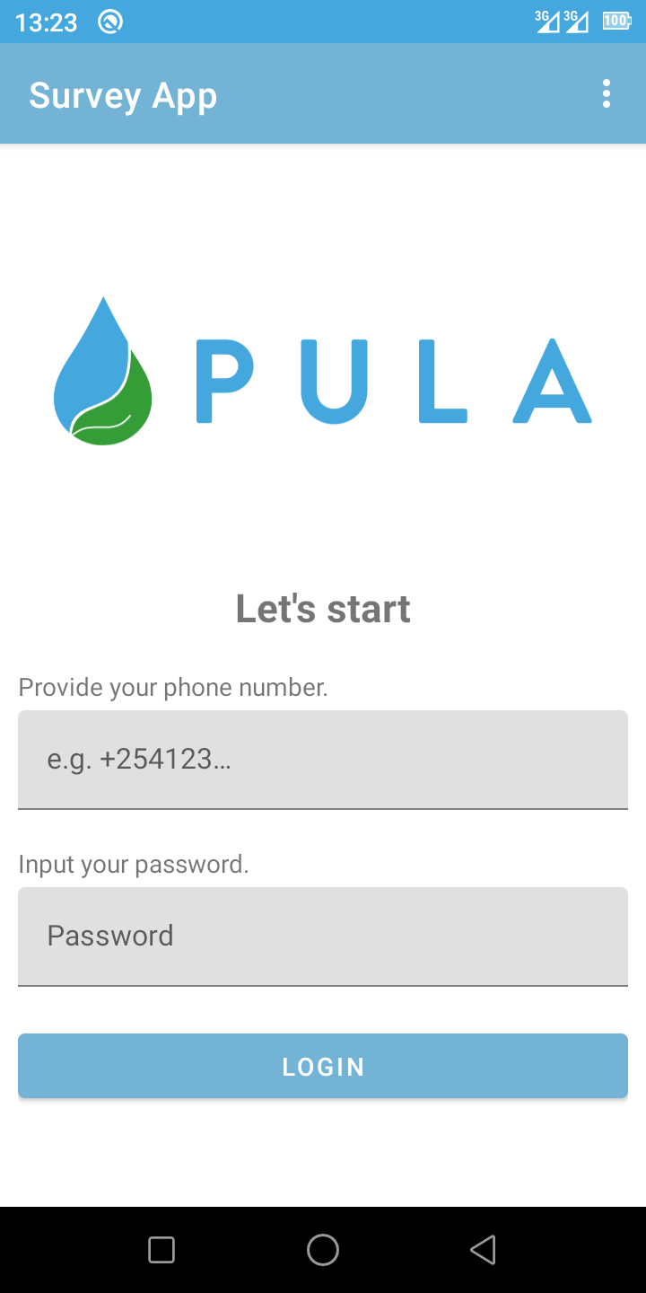
OUTPUT:

Slide 23
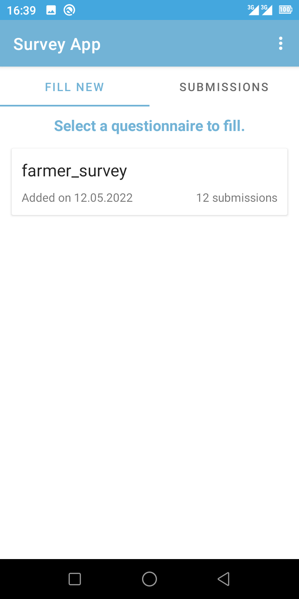

Slide 24
